Slide 1


Data to action
analysis of automotive industry
Jennie Franco
may 2023

Slide 2
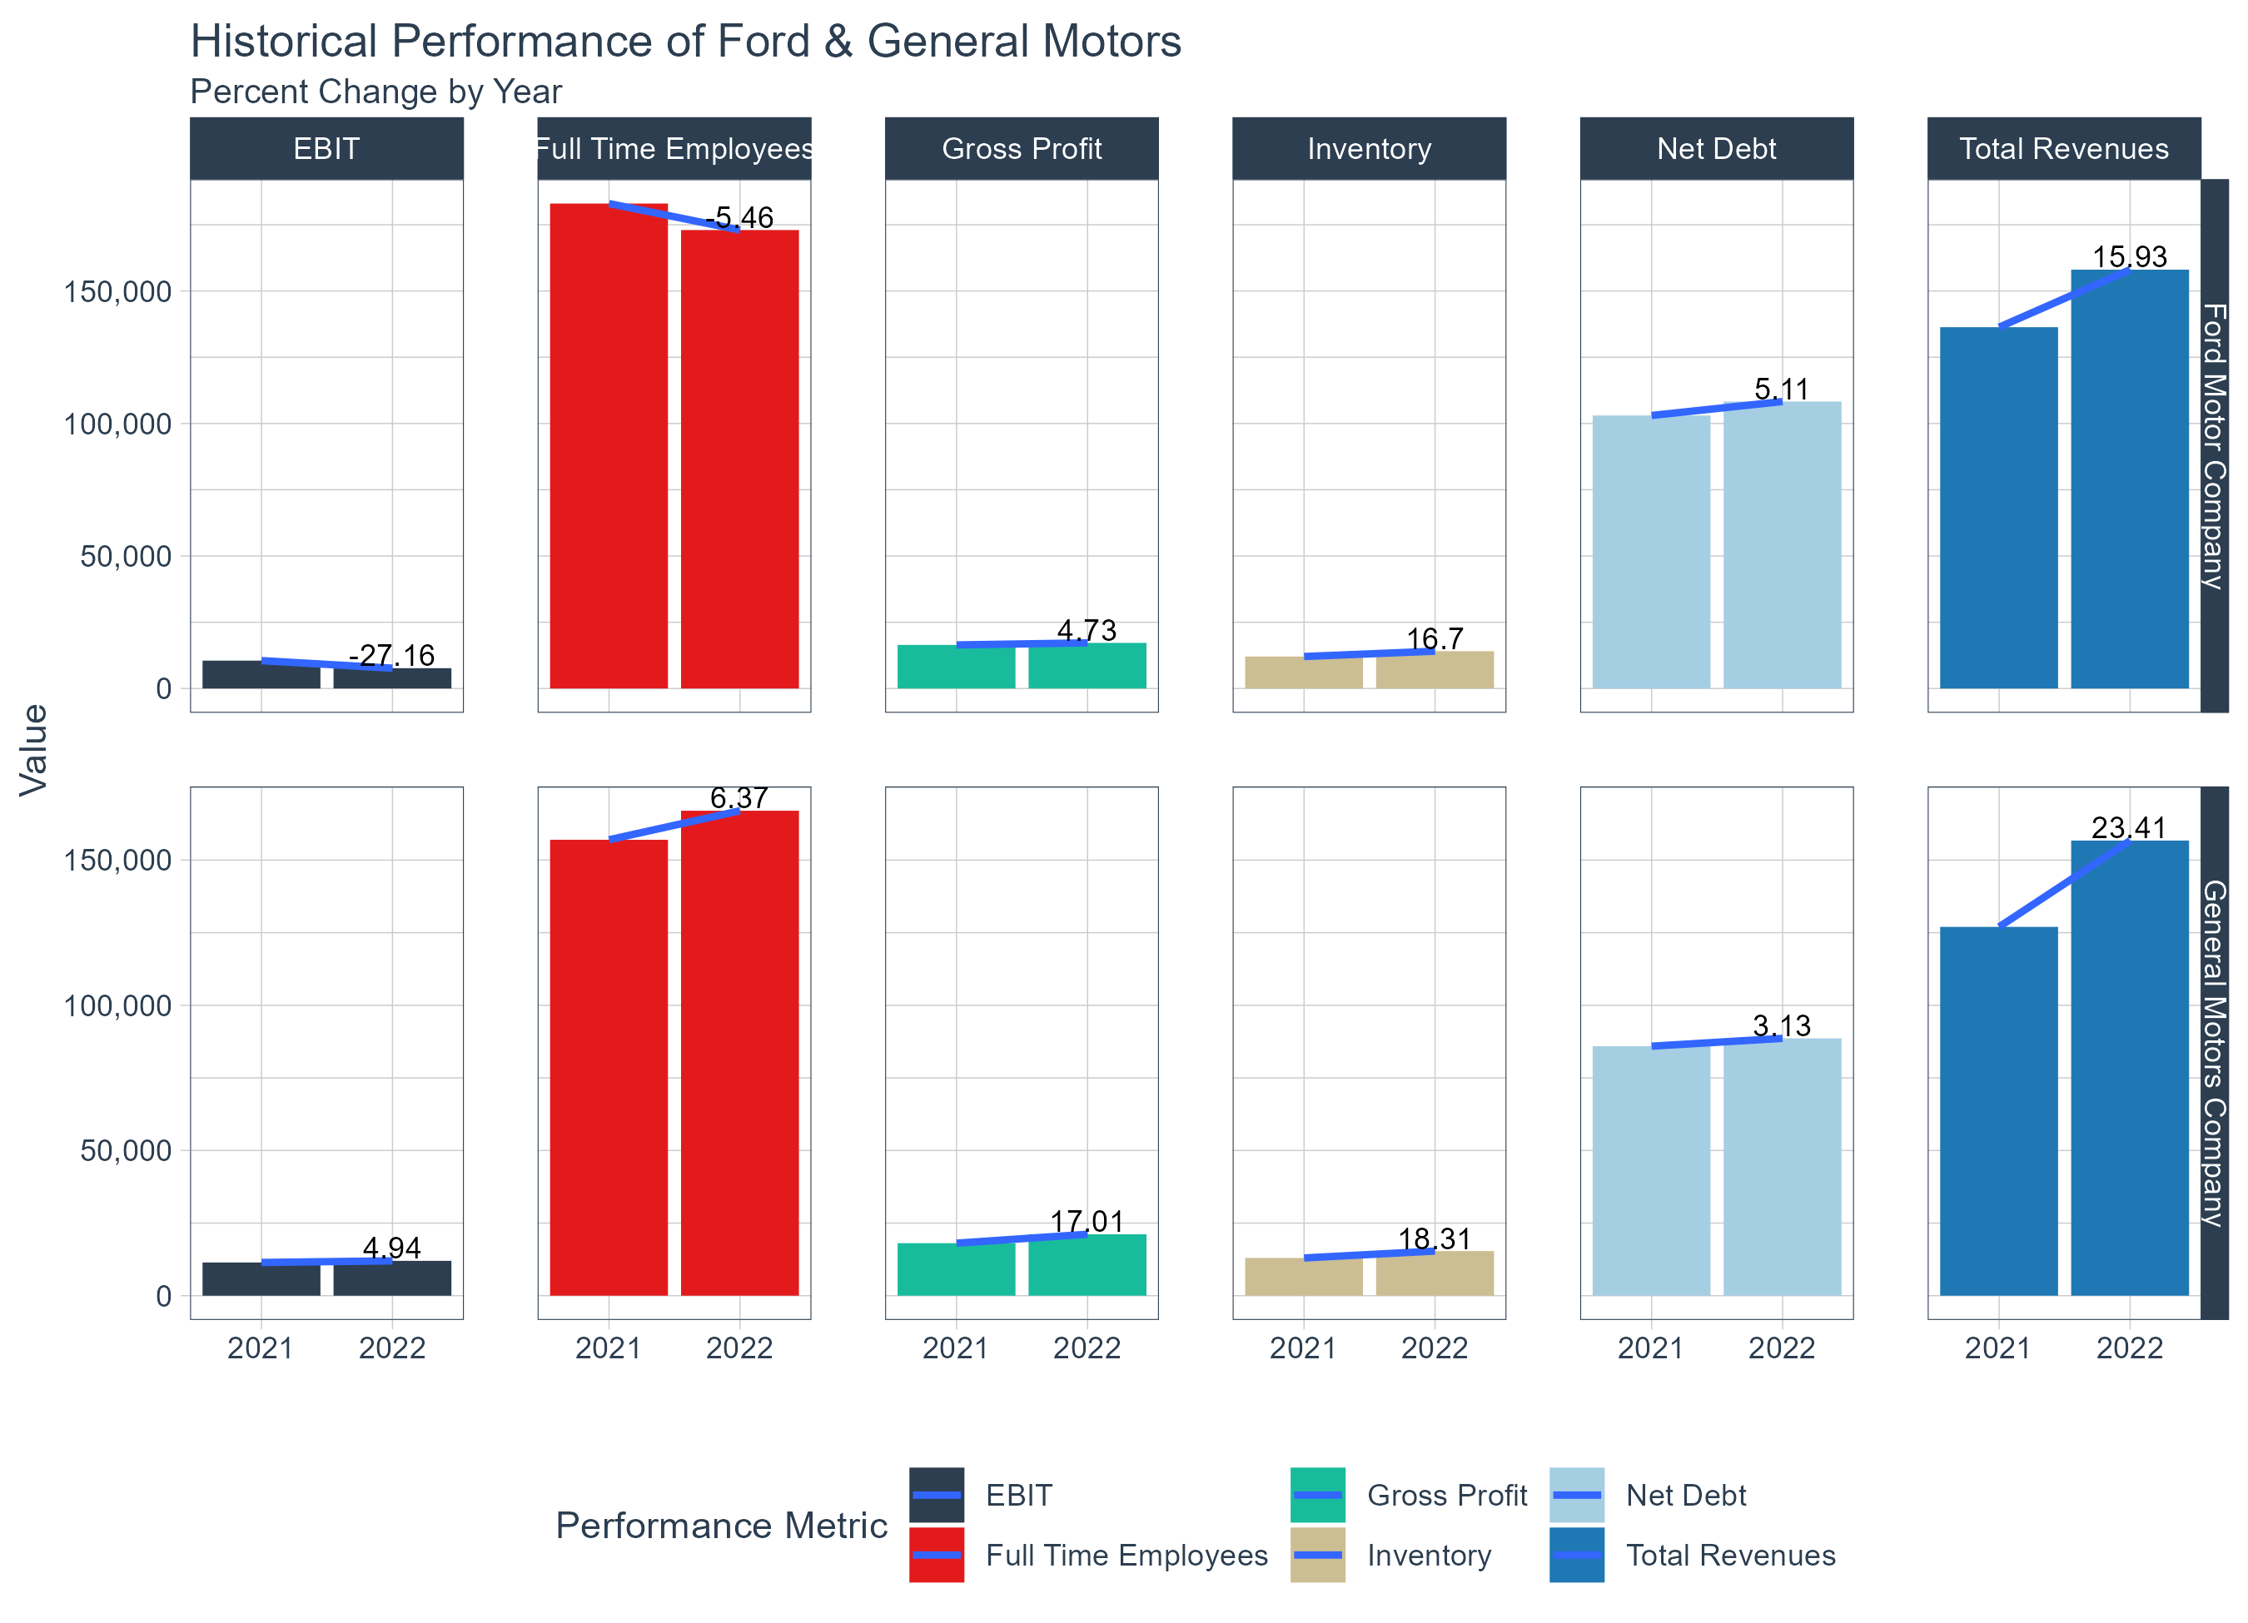
General Motors fares better than the competition
How does Ford's Revenue compare with general motors' revenue?
Ford had a 15.9% increase in Total revenue from 2021 to 2022. It rose from $136 billion in 2021 to $158 billion in 2022. While their gross profit had an increase of near 5%.
General Motors' Total revenue for 2022 was $156 billion, an 23.4% increase from the previous year. With a 17% increase in gross profit.
However, both companies saw an increase in net debt with a percent change of more than 3%, meaning they have accumulated more debt over the past 12 months.

Slide 3
Number of Employees: 2021 - 2022
The number of employees in two of the largest automotive brands in the United States are more than 100,000.
Ford saw a decrease of 5% from the previous year, while GM employed more full time workers increasing their workforce by 6% in 2022.

Slide 4
A look at the shareholders of Ford Motor company
8.4%
7.6%
6.5%
3.7%
The Vanguard Group holds the most ownership at 8%
Ford Motor Company is one of the largest car manufacturers in the world. A look at the shareholders according to S&P Global data, reveals that the Vanguard Group is their biggest institutional shareholder with 335,643,986 shares, 8.4% of shares outstanding as of 2022.
Followed by State Street Global Advisors, Inc owning 7.6% of shares outstanding. And BlackRock, Inc owning more than 260 million, about 6.5% of shares outstanding.

Slide 5
Who owns General Motors?
12.1%
9.01%
7.9%
Capital Research & Management Company holds the most ownership at 12%
General Motors Company is an American multinational automotive manufacturing company in the US, founded in 1908.
As of 2022, Capital Research & Management Co holds more than 169,128,690 number of shares, a 12% of shares outstanding.
Vanguard, BlackRock, BNY Mellon, and StateStreet Global are among the top 15 institutions that have substantial ownership in both Ford and GM.

Slide 6

Are stock prices correlated to trading volumes?
FORD MOTOR COMPANY
GEneral Motors Company
The stock prices and trading volumes of both Ford and General Motors are evaluated to see if a relationship exists.
p = 0.45
p = 0.19
Variable 1: Trading Volume
With a Pearson correlation value of 0.45, there is a positive and moderate relationship between trade volume and stock price for Ford Motor Company. This means there is room to believe that as the stock prices go up, then trading volumes increase.
With a Pearson correlation value of 0.19, there is a positive and weak relationship between the two variables for General Motors' Company. The coefficient here is quite low.
Trading Volume is the amount of security that was traded during a given period of time. (Investopedia)
Variable 2: Stock Price
Stock Price refers to the current price that share of stock is trading for on the market. (Corporate Finance Institute)

Slide 7



Inventory Analysis
 | 2021 | 2022
Ford | 38.40 | 38.25
General Motors | 47.12 | 44.19
Days Inventory Outstanding
According to Investopedia, The days inventory outstanding ratio is calculated as inventory divided by the cost of goods sold (COGS) and then multiplied by 365.
This ratio measures the average number of days a company holds inventory before selling it. Holding unsold inventory is costly.
The ratio of inventory for Ford has remained relatively the same around 38 in the past two years and has slightly decreased for General Motors from 47 to 44.
Overall, the ratio has not increased over time for both automakers, which signifies that these companies are managing their inventory quite well.
Days Inventory Outstanding
=
Average Inventory
x 365
Cost of goods sold
Ford & general motors manage their inventory quite well

Slide 8
Resources
Links to resources of formulas & definitions
Trading Volume Definition: Investopedia.com
Stock Price Definition: Corporate Finance Institute
Days Inventory Outstanding Formula: Investopedia.com
S&P Global Data
Analysis of Ford and GM were conducted in Databricks using SQL and Python, and further visualizations and correlations were performed in R.

Slide 9
Thank YOU

